Slide 1
PDA Course Project
DATA ANALYSIS ON A
MERGED DATASET AFTER CLEANING
AUTHOR NAME:
XUE LIU
ASHRAF ALSABBAGH
SUMISSION DATE: 17-AUG-2023

Slide 2
Executive Summary
Project Objectives
Methodology
Key Findings
Conclusion

Slide 3
Project Objectives :
After cleaning the three datasets, merge them together, and perform detailed analyses such as calculating the average GDP for each country, identifying the country whose GDP changed the largest, or estimating the population etc.
Methodology :
This analysis uses some functions in the Pandas library such as:
read_excel(), read_csv()_merge(), cut(), idmax(), set_index(), sort_values(), corr(), apply(), map(), groupby(), replace(), str.replace(), unique(), mean(), median(), size(), head(), info(), loc[], iloc[], index[] and lambda.
Also, use the np.polyfit() in the Numpy and the plt.scatter() in the matplotlib library.

Slide 4
Q1
Cleaning Data

Slide 5
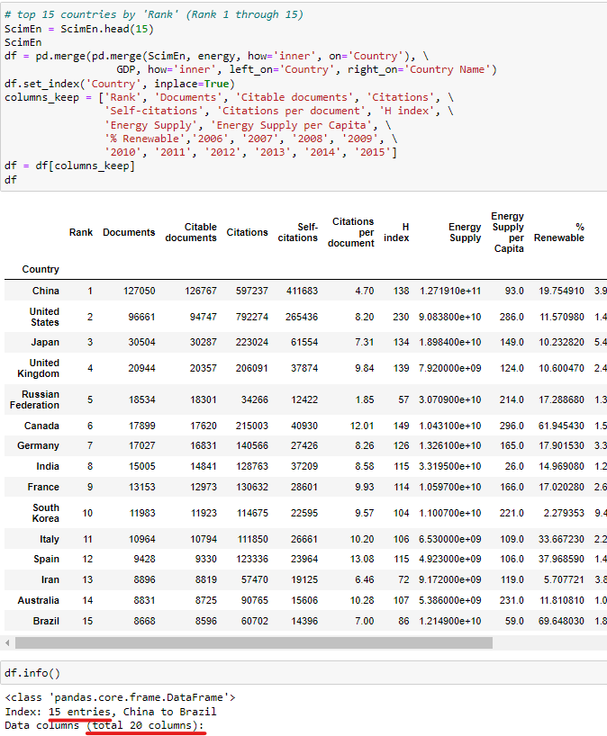
Q1 : Cleaning Data
f) Join the GDP, Energy, and ScimEn datasets into a new dataset.
1. Use only the last 10 years (2006-2015) of GDP data and only the top 15 countries by ScimEn 'Rank' (Rank 1 through 15), use head() to choose the top 15 countries.
2. Use merge() to inner join the three datasets: GDP, Energy, and ScimEn.
3. The index of this Data Frame is the name of the country, use set_index(inplace=True) to give the index to the data frame.
4. The final Data Frame is 20 columns and 15 entries, use info() to check all information of the data frame.

Slide 6
Q2 – Q12
Analyses Data

Slide 7
Key Findings: #1
The country with the greatest average GDP change is 7 times larger than the sixth-largest country.
However, we are unable to compare the GDP change for the country with the greatest average to the country with the lowest average

Slide 8
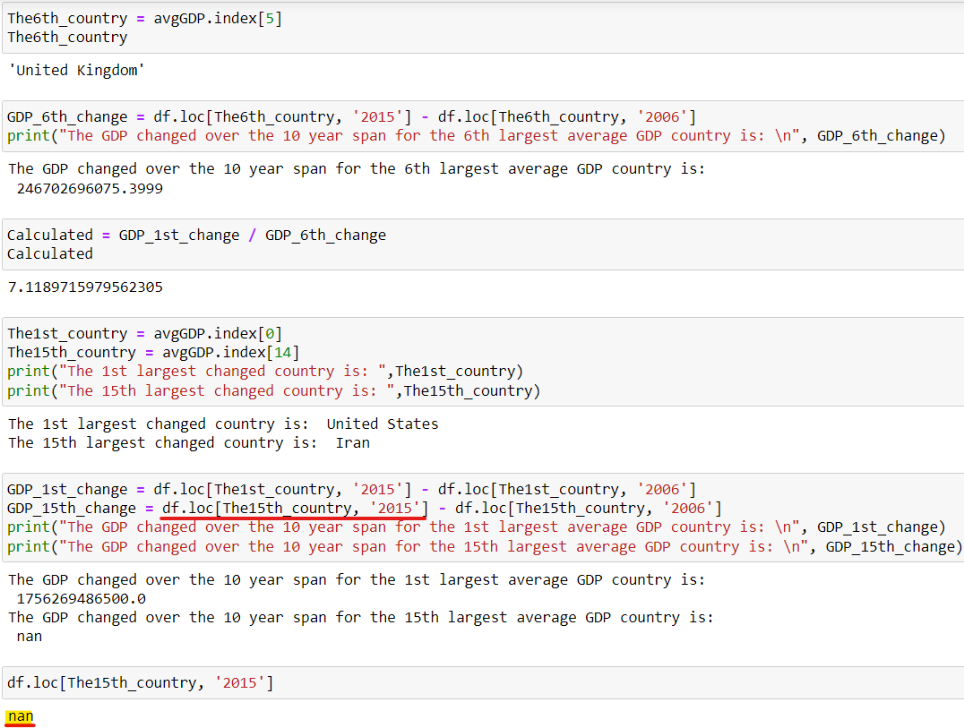
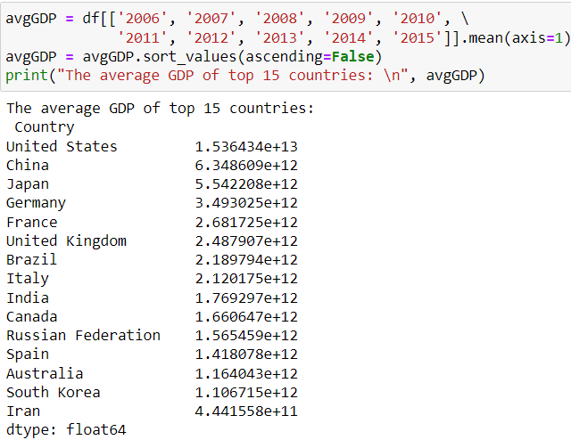
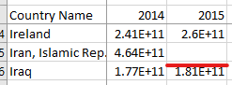

Q3 : How much had the GDP changed over the 10-year span for the 6th largest average GDP country?
Use index[] to find the 6th largest changed average GDP country, and use loc[] to calculate the GDP change.
Q2 : What are the top 15 countries for average GDP over the last 10 years?
1. Calculate the top 15 countries with mean(axis=1) for average GDP of each country.
2. Return a Series and sort the Series with sort_values() in descending order.

Slide 9
Key Findings: #2
The country with the highest per capita energy supply is Canada. However, Canada is not the country with the highest renewable rate.
The country with the highest renewable rate is Brazil, but Brazil's per capita energy supply is the second-lowest.

Slide 10
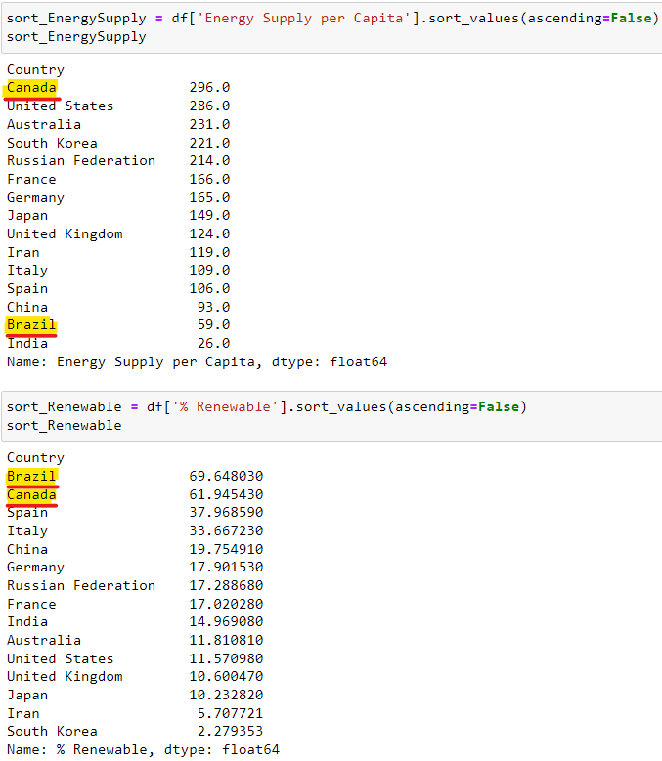
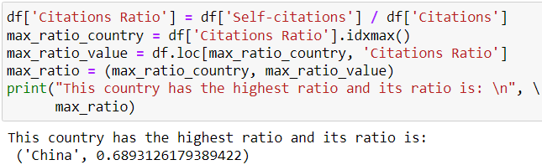
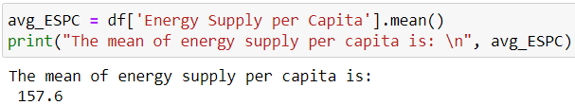
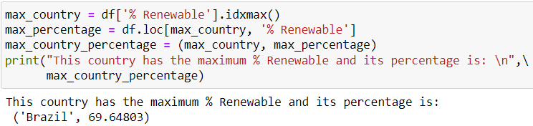
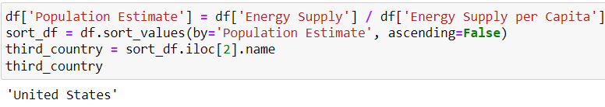
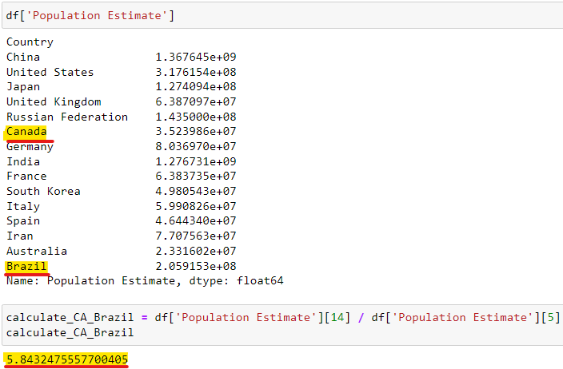
Q6 : Which country has the highest ratio and what is the ratio?
Use idxmax() to find the country with the maximum ratio, and use loc[] return this country's ratio.
Q7 : What is the third most populous country according to population estimate?
1. First use sort_values() in descending order, the third row is the third most populous country.
2. Use iloc[2].name to return the third row's country name.
Q4 : What is the mean energy supply per capita?
Use mean() to find the mean of energy supply per capita.
Q5 : Which country has the maximum % Renewable and what is the percentage?
Use idxmax() to find the maximum % Renewable country, and use loc[] to return this country's percentage.
The factor
contributing to this difference might be due to Brazil's population being 5.8 times larger than Canada's population.

Slide 11
Key Findings: #3
The correlation between the number of
citable documents per capita and the energy supply per capita is 0.794 which indicates a strong positive linear relationship between them.

Slide 12
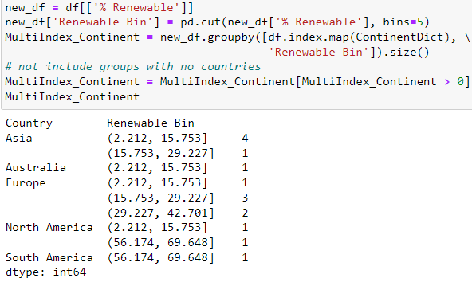
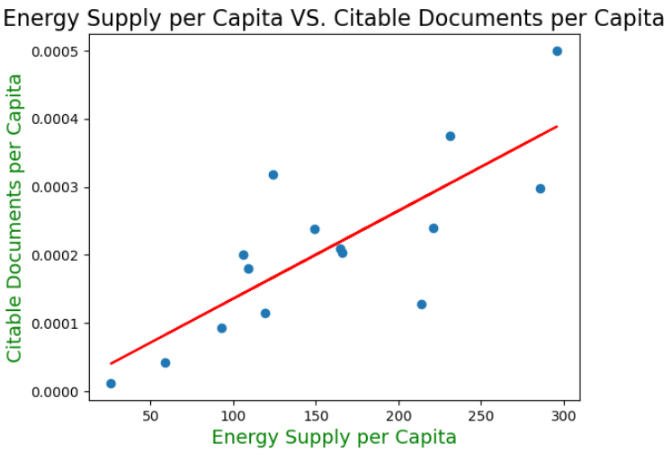
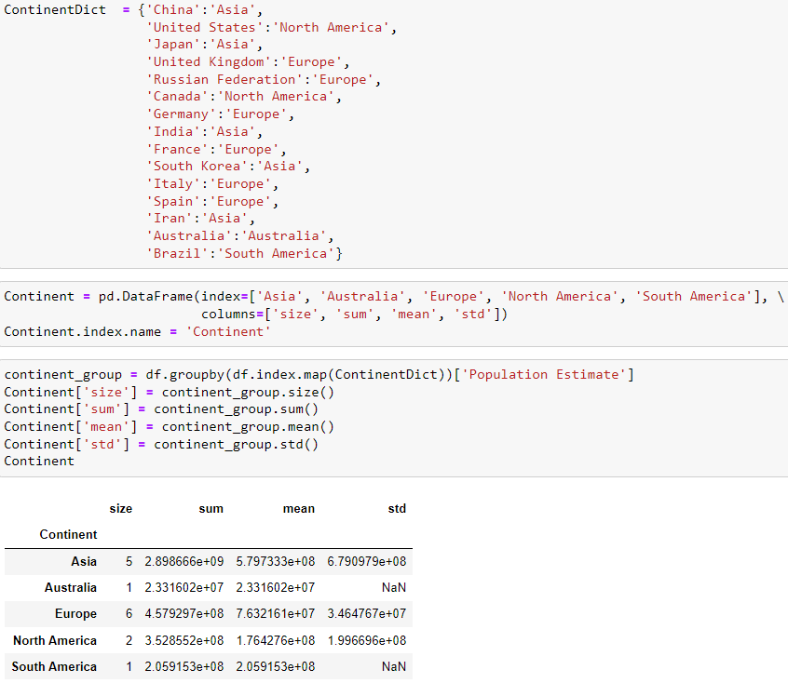
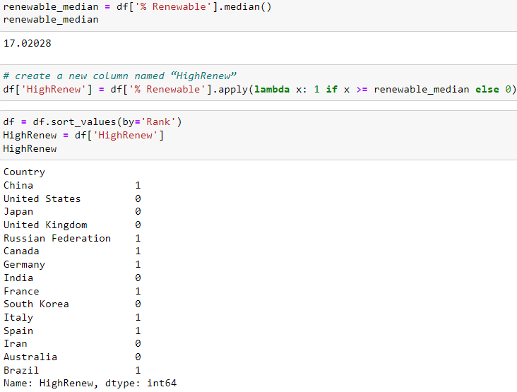
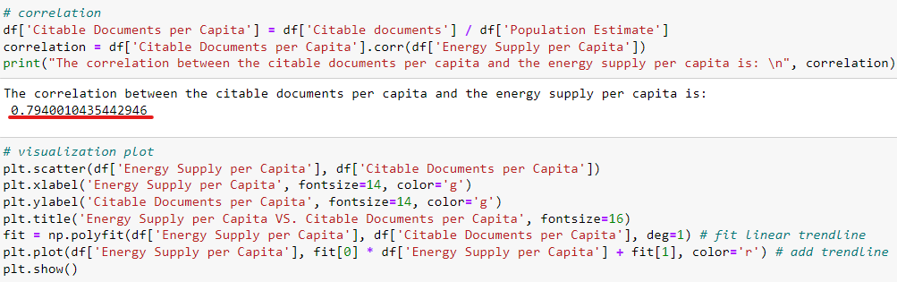
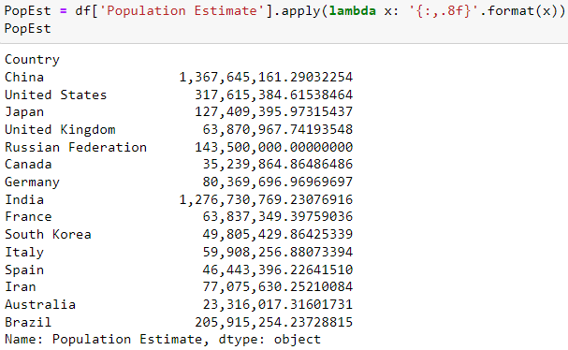
Q8 : What is the correlation between the number of citable documents per capita and the energy supply per capita? Plot to visualize the relationship
1. Create a column that estimates the number of citable documents per person.
2. Use corr() to find the correlation between the number of citable documents per capita and the energy supply per capita.
3. Use plt.scatter() to visualize a scatter plot. In order to beautify this plot, use fontsize and color.
4. Additionally use np.polyfit() to fit a linear trendline, use plt.plot() to add the trendline.
Q11 : Cut % Renewable into 5 bins. How many countries are in each of these groups?
1. Use pd.cut(bins=5) to cut % Renewable into 5 bins, use groupby().size() to group these new % Renewable bins.
2. Return a Series, but not include groups with no countries.
Q12 : Convert the Population Estimate series to a string with thousands separator (using commas).
Use apply(lambda) to format the values
Q10 : Group the Countries by Continent and display some descriptive statistics measures.
1. First, Create a data frame with an index named 'Continent' according to the division of continents.
2. Then use groupby() and map() to group the Countries by Continent.
3. Use size() sum() mean() std() to display the sample size, sum, mean, and std deviation for the estimated population
Q9 : Determines the Renewable value of each country above or below the median.
1. Find the median of Renewable for top 15 countries.
2. Create a new column named “HighRenew”, use apply(lambda) to determine the Renewable value of each country above or below the median.
3. Return a series whose index sorted in ascending order of rank.

Slide 13
Conclusion
In conclusion, the findings contribute to a deeper understanding of the direct and indirect relationships between population, energy supply, and renewable rates contributing to further optimizing the energy structure of each country.

Slide 14
Thanks！

